Slide 1
DANIEL DEFOE. HIS LIFE AND WORK. “ROBINSON CRUSOE”
автор: Манько В.А., учитель англ.мови Будянського технологічного ліцею Харківської районної ради Харківської області

Slide 2
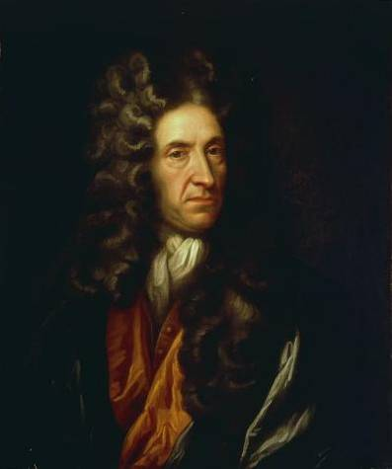
Daniel Defoe (1660 – 1731) was born in the family of nonconformists (Dissenters)-those who refused to accept the rules of an established national Church.
His father, a butcher, was wealthy enough to give his son a good education. Daniel was to become a priest in the Nonconformist Church, but when his training was completed, he decided to engage in business as a hosier. It was his cherished desire to become wealthy, but his wish was never fulfilled.

Slide 3
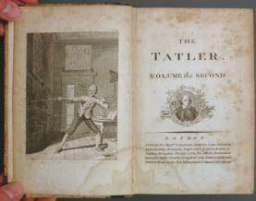
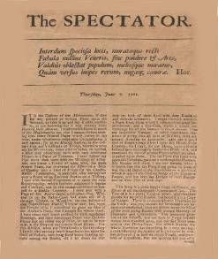
He went bankrupt several times. He was always deep in debt. The only branch of business in which he proved successful was journalism and literature.
Daniel Defoe was the founder of the early bourgeois realistic novel and the father of English periodicals.
“The Review which he founded in 1704 and conducted until 1713, is regarded as the first English newspaper.
It paved the way to the magazines “The Tatler “ and “The Spectator”.

Slide 4
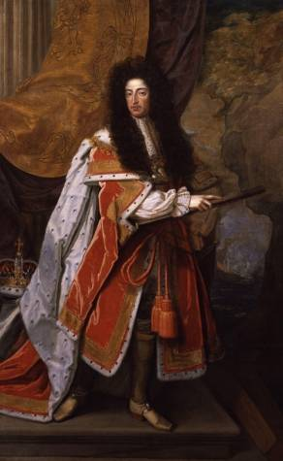
When Defoe was twenty-three, he started writing pamphlets on questions of the hour.
When the Protestant King William III was placed on the throne(1689), Defoe started writing pamphlets praising his policy. Due to the fact that William III was supported by the Whig party, he was continually attacked by the Tories.

Slide 5
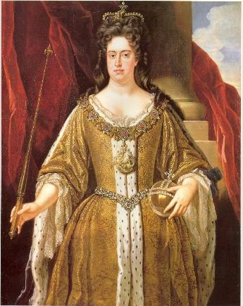
During the reign of Queen Anne (1702 -1714), persecution of the Dissenters began again, as in the reign of James II.
Defoe wrote a pamphlet in defence of the Dissenters, in which he attacked the Tories and the established Church.
The author was sentenced to seven years’ imprisonment.

Slide 6
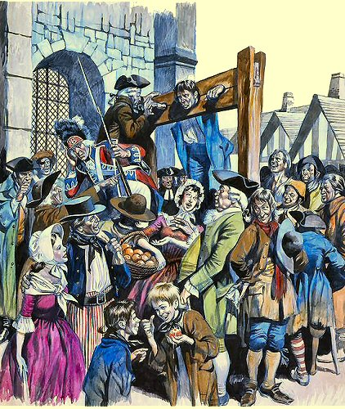
In order to disgrace him, the Tories subjected Daniel Defoe to a cruel punishment: he had to stand in the pillory in a public square with his head and hands in stocks. People gathered round him and cheered him while he stood there, women threw flowers to him, and when the time came for him to be set free, people carried him from the square on their shoulders.

Slide 7
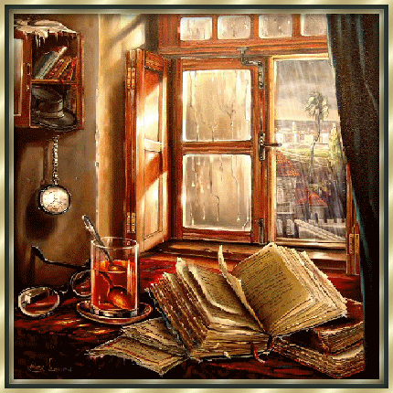
That was the climax of his political career and the end of it. Later Daniel Defoe became the editor of the magazine which supported his former enemies, the Tories. After Queen Anne’s death, when the Whigs came to power, Defoe began to serve them again.

Slide 8
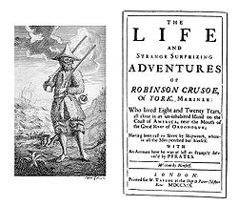
In 1719, Daniel Defoe tried his hand at another kind of literature – fiction, and wrote the novel which brought him world-wide fame –”The Life and Adventures of Robinson Crusoe”.
After the book had been published Defoe became famous and rich and was able to pay his creditors in full.
Now he wrote for four public
magazines and received a regular sum of money from the government.

Slide 9
Besides “Robinson Crusoe”, Daniel Defoe wrote some more novels which were popular during his lifetime, but we do not hear much about them now. They are:
“The Life of Captain Singleton”,
“The Fortunes and Misfortunes of Moll Flanders”,
“The History of Colonel Jack,”’
“A History of Lady Roxana”.
In 1729, while at work on the book “The Complete English Gentleman”, Defoe fell ill and in two years’ time he died.

Slide 10
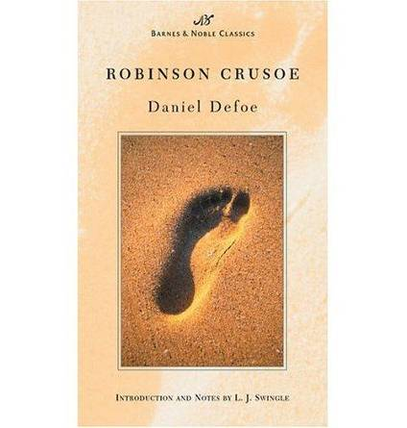
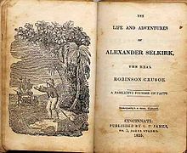
“Robinson Crusoe”
Books about voyages and new discoveries were extremely popular in the first quarter of the 18th century. A true story that was described in one of the magazines, attracted Defoe’s attention. It was about Alexander Selkirk, a Scottish sailor, who had quarreled with his captain and was put ashore on a desert island near South America where he lived alone for 4 years and 4 months.
In 1709 he was picked up by a passing vessel.

Slide 11
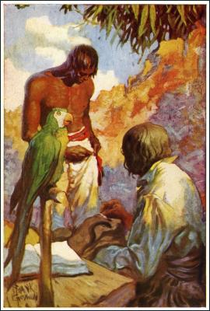
Daniel Defoe made his hero, Robinson Crusoe, spend 26 years on a desert island.
At the beginning of the story the hero is an inexperienced youth, who develops into a strong- willed man, able to withstand all the hard ships. Robinson Crusoe’s most characteristic trait is his optimism. He is an enthusiastic worker and always hopes for the best.

Slide 12
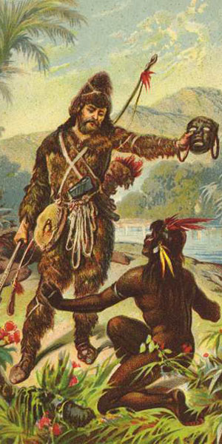
Robinson Crusoe is very practical. The beauty of the island has no appeal to him, he regards the island as his personal property. He is proud to be master of it.
He believes in God and in the hand of Providence. In desperate moments he turns to God for help.
The other central character is Friday. He is intelligent, generous and skilful. He is portrayed as a kind-hearted man.

Slide 13
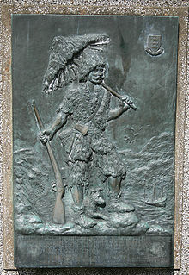
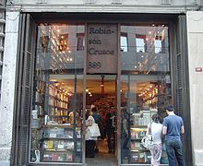
The novel stirs the imagination of people of all ages and all times. The book is a glorification of human labour, a triumph of man over nature. It is not only a work of fiction, an account of adventures, a biography; it is a study of man in relation to labour, to nature, to private property.
Daniel Defoe was a true writer of the Enlightenment. He introduced the common man as the key-character of his novel.
The story is told in the first person; this produces the impression that the author himself lived through all the adventures described by him.

Slide 14
ВИКОРИСТАНІ ДЖЕРЕЛА:
Гордєєва Н.М. Англійська література: Навч. посібник для шкіл з поглибл. вивч. англ.мови. – К.: Равлик, 1998. – 286 с.
Кукурян И.Л., “An Outline of English Literature”, М., изд-во МГУ, 1997г.
Волосова Т.Д., Геккер М.Ю.,”English Literature”, ч.1., М., изд-во «Просвещение», 1977г.
Малюнки та ілюстрації:
http://en.wikipedia.org/wiki/Robinson_Crusoe
http:// dic.academic.ru/dic.nsf/ruwiki/842465
http://www.twcenter.nt/forums/showthread.php?t=327171
http://ruslit.com.ua/russian_classic/defo_d
http://hapala.ru/news/2790
http://poetree.ru/new/
http://hubpage.com/hub/Top-10-Novels-Ive -Read-in-Pictures
http:www.cosmovisions.c
http://public.fotki.com/zileivebl/robinson-crusoe
http://www. allposters.com/-st/book-Illustration-posters-c108179_p26-htm

